Slide 1
DQI and SQI Decisions
Notes:
This is the thirteenth presentation in the 18-part series for CWB training. The following slides cover DQI and SQI decisions and how to annotate them in the CWB tool.

Slide 2
DQI and SQI Decisions
Qualifications
Eval of Record of at least Outstanding or no more than 10% of your top performers
Not on Retained Pay or otherwise ineligible for salary increase (col. T)
For DQI: No DQI (or equiv) within the last year at the same grade (DX and DY)
For SQI: No SQI (or equiv) in last three years at the same grade
Salary is not less than 1 step increase (DQI) or 2 step increases (SQI) away from the grade maximum (step 12 equiv)
Calculation
Based on Grade as of extract date (col. AA)
Admin must set SQI eligibility (Yes/No) flag in col. EK
“Yes” flag allows SQI (two step) award in col. EL
Grade may change between extract date and payout date; $$ amount in CWB is only a projection
Total DQI/SQI fund and amount remaining tracked in EM8 and EM9 – not taken from the bonus fund
Notes:
CWB can check some things, like date and amount of last DQI or SQI, but admin must certify eligibility (based on last two years of ratings).
Qualifications: Top 10% and a Evaluation of Record of at least outstanding.
For more information, view DoDI 1400.25-V2008, Enclosure 3, Paragraph 4.

Slide 3
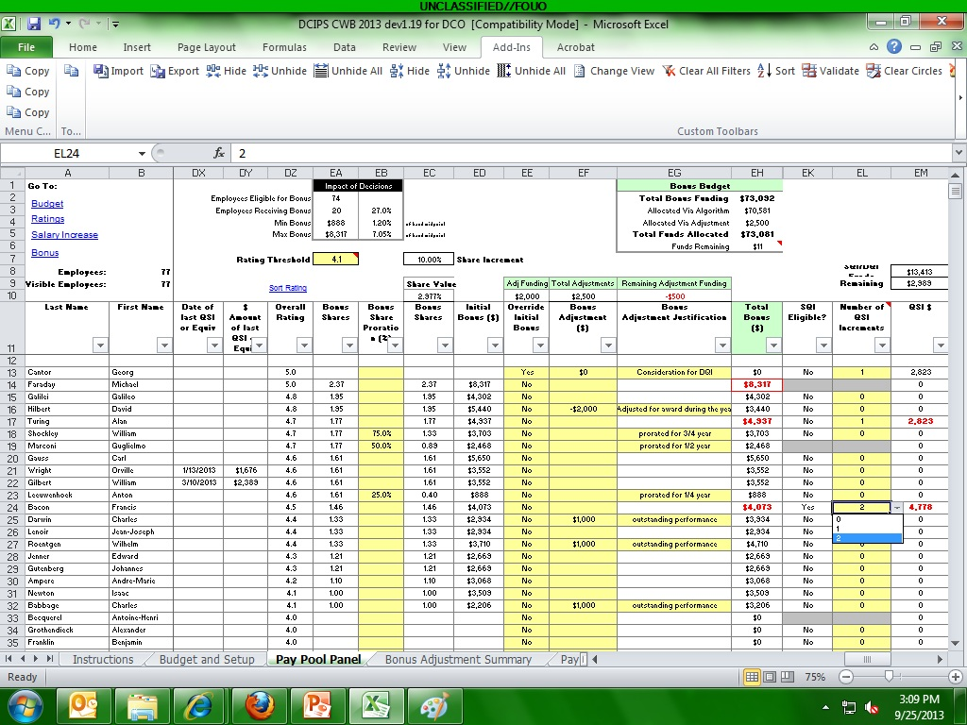
DQI/SQI
Notes:
The DQI/SQI columns are to the right in the bonus section just before the final Wildcards. The columns detailing the date and amount of last “QSI or equivalent” are in DX and DY at the beginning of the Bonus section. Admin must click “Yes” to “SQI Eligible” to give an employee 2 steps. Bonus amount and DQI/SQI amount will display in RED if both bonus and DQI or SQI are awarded (only a flag). Bonus amount will display in RED with a red box around the amount if it exceeds the maximum bonus from the Budget and Setup sheet. Amount remaining in the DQI/SQI fund is displayed in EM9.
DOUBLE CHECK DATA – RED MEANS TO VERIFY DATA.

Slide 4
To continue CWB training, view next presentation
“Bonus Decisions”
Notes:
This concludes the thirteenth presentation in the 18-part series for CWB training. To continue training, view the next Presentation, entitled Bonus Decisions.

